Slide 1


Time Series Analysis:
An Introduction with Python
Group 5
Hamed Zakeri, Sina Davari, Gurkaran Sran, Farshad Tajeddini
Samiramis Khazaei, Anbumanivel Mohan Suganthi, Dhilip Ilanseran
January 2023
Time Series
Time Series Models
Questions?
Introduction

Slide 2
Outlines
Introduction
Definition of Time Series Data
Basic Concepts of Time Series Analysis (Stationarity, White Noise, Autocorrelation, etc.)
Time Series Characteristics
Patterns (Trend, Seasonality, Cycle)
Decompositions
Time Series Models
Mean Model
Linear Trend Model
Random Walk Model
Moving Average Models (ARMA & ARIMA, SARIMA, Exponential Smoothing)
Autoregressive Models (ARCH & GARCH)
Time Series
Time Series Models
Questions?
Introduction

Slide 3

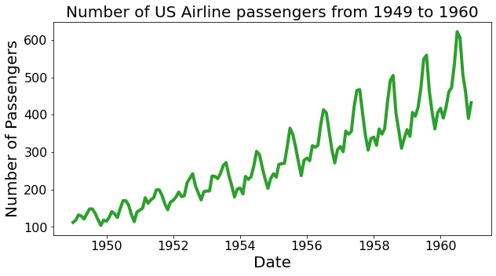
Time Series Data
What is “Time Series Data?”
Data recorded over time, typically at regular time intervals (e.g., hourly, monthly, daily, etc.)
Time Series
Time Series Models
Questions?
Introduction
1/22

Slide 4
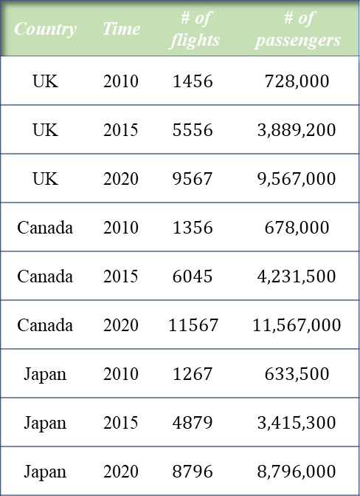
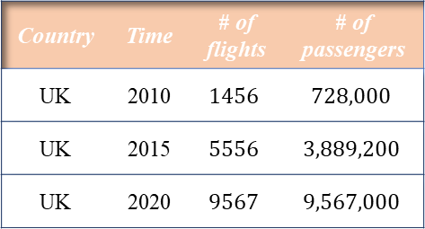
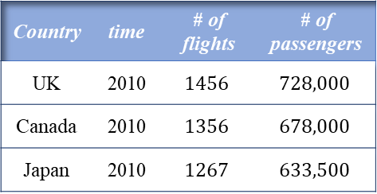
Types of Data
Country | time | # of flights | # of passengers
UK | 2010 | $$1456$$ | $$728,000$$
Canada | 2010 | $$1356$$ | $$678,000$$
Japan | 2010 | $$1267$$ | $$633,500$$
Country | Time | # of flights | # of passengers
UK | 2010 | $$1456$$ | $$728,000$$
UK | 2015 | $$5556$$ | $$3,889,200$$
UK | 2020 | $$9567$$ | $$9,567,000$$
Cross-sectional Data
Observations from multiple individuals at the same point in time or at different points in time (time does not play any significant role in the analysis).
Country | Time | # of flights | # of passengers
UK | 2010 | $$1456$$ | $$728,000$$
UK | 2015 | $$5556$$ | $$3,889,200$$
UK | 2020 | $$9567$$ | $$9,567,000$$
Canada | 2010 | $$1356$$ | $$678,000$$
Canada | 2015 | $$6045$$ | $$4,231,500$$
Canada | 2020 | $$11567$$ | $$11,567,000$$
Japan | 2010 | $$1267$$ | $$633,500$$
Japan | 2015 | $$4879$$ | $$3,415,300$$
Japan | 2020 | $$8796$$ | $$8,796,000$$
Time Series
Time Series Models
Questions?
Time series data
A sequence of data from a natural or social process (or a trial) observed over time.
Introduction
Panel data
Multiple entities over multiple points in time. A panel data also known as longitudinal data.
2/22

Slide 5
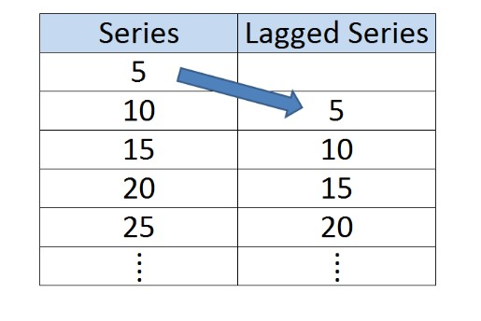
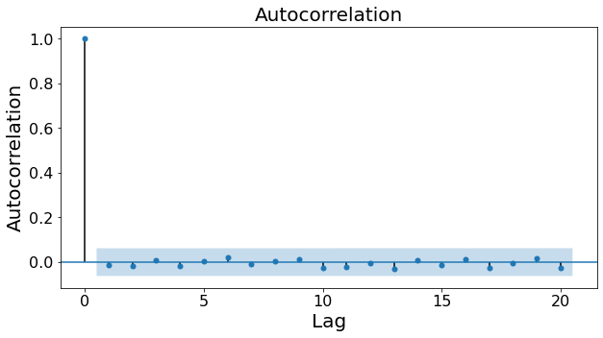

Basic Concepts of Time Series Analysis
Autocorrelation
Time series is linearly related to a previous version of itself.
Univariate time series consists of single observations recorded sequentially over equal time increments.
Autocorrelation measures the linear relationship between lagged values of a time series
𝑎𝑢𝑡𝑜𝑐𝑜𝑟𝑟𝑒𝑙𝑎𝑡𝑖𝑜𝑛 (𝑥,𝑙𝑎𝑔) = 𝑐𝑜𝑟𝑟 ($x_{t}$,$x_{t+lag})$
Autocorrelation Function (ACF)
Shows the entire autocorrelation function for different lags.
Any significant non-zero autocorrelations implies that the series can be forecast from the past.
Time Series
Time Series Models
Questions?
Introduction
3/22

Slide 6
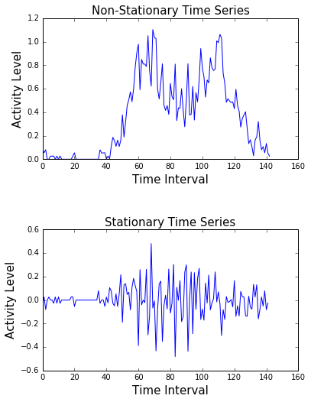


Basic Concepts of Time Series Analysis
Stationary
A time series {$X_{t}$} is strictly stationary if :
{$X_{1}$,.., $X_{n}$} and {$X_{1+k}$,.., $X_{n+k}$} possess the same joint distribution for any integer n ≥ 1 and any integer k.
Weak Stationary:
mean stationary if :
E($X_{t}$) = μ is a constant.
Variance stationary if :
Var($X_{t}$) = E $[({x_{t} − μ_{t}) }^{2})$] = $σ^{2}$ is a constant.
If a time series is both mean stationery and variance stationary, then its time series plot fluctuates around the mean line y = μ.
Time Series
Time Series Models
Questions?
Introduction
4/22

Slide 7
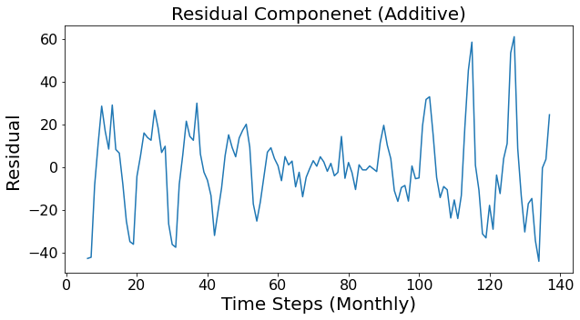
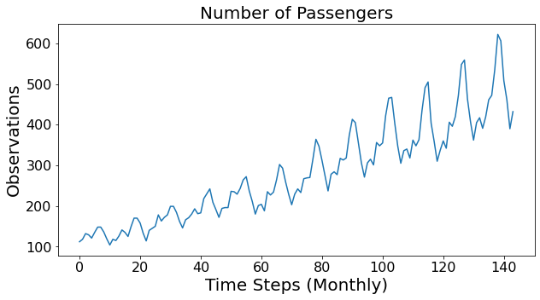
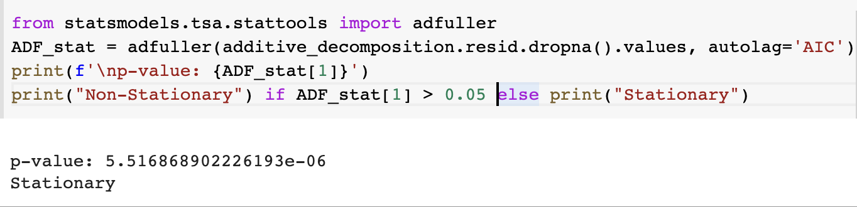
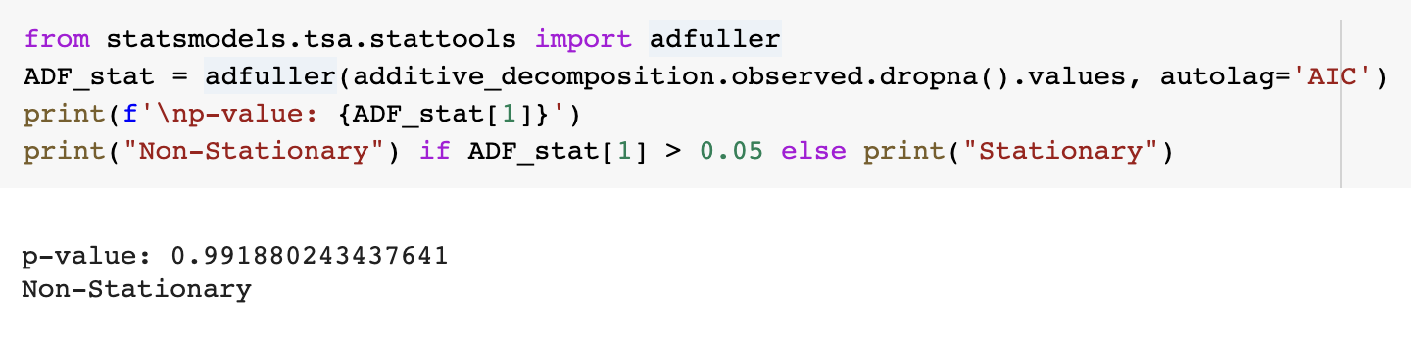
Basic Concepts of Time Series Analysis
Augmented Dicky-Fuller Test
Null Hypothesis : Series in non-stationary
Time Series
Time Series Models
Questions?
Introduction
5/22

Slide 8
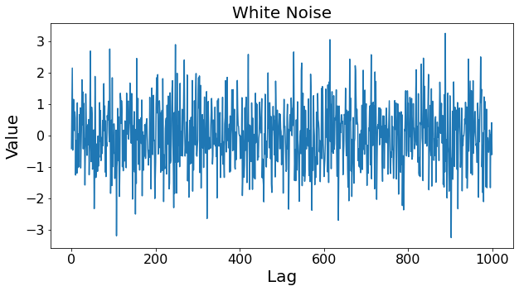
Basic Concepts of Time Series Analysis
White Noise
Constant mean
Constant variance
Zero autocorrelations at all lags
Time Series
Time Series Models
Questions?
Introduction
6/22

Slide 9
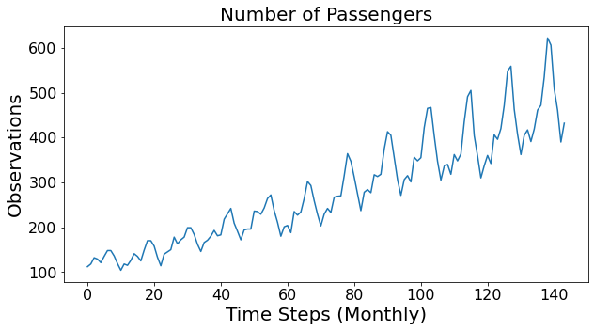
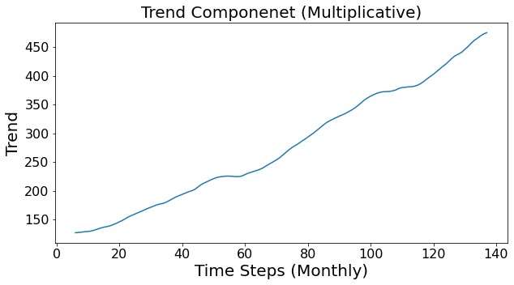
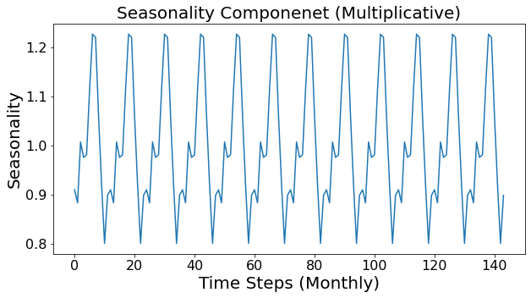
Time Series Patterns
Trend
long-term increase or decrease in the data.
Seasonality
affected by seasonal factors such as the time of the year, or the day of the week.
Time Series Models
Questions?
Introduction
Time Series
Cycle
Rise and fall pattern in the series that does not happen in fixed calendar-based intervals.
7/22

Slide 10
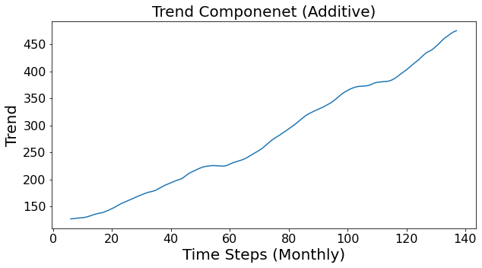
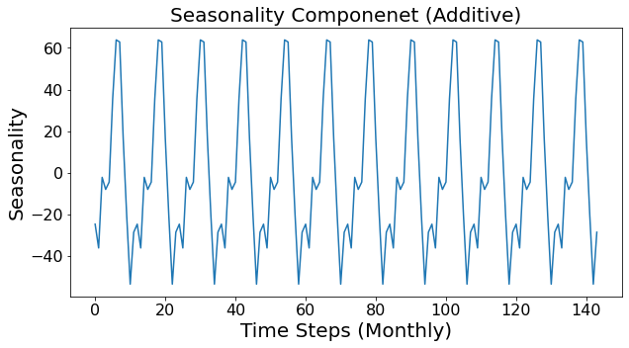
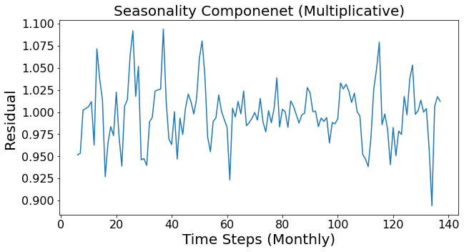
Time Series Decompositions
Three Components
1) Trend, 2) Seasonality, 3) Residuals
Time Series Models
Questions?
Introduction
Time Series
Additive Decomposition
Series = Trend + Seasonality + Residuals
Multiplicative Decomposition
Series = Trend × Seasonality × Residuals
8/22

Slide 11

Time Series Models
Let’s model
Questions?
Time Series
Introduction
9/22
5/12

Slide 12
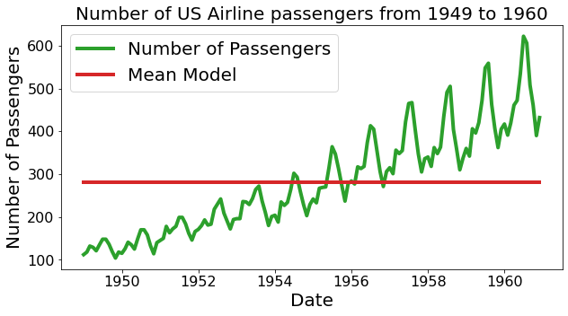

Mean Model Example
Mean Model:
$Y(t)$= $\overline{Y}$
Time Series
Questions?
Time Series Models
Introduction
10/22
5/12

Slide 13
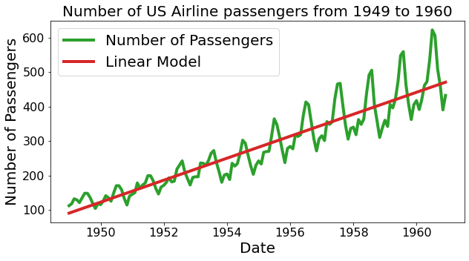

Linear Trend Model Example
Linear Trend Model : $Y(t)=β_{0}+β_{1}X(t)$
Time Series
Questions?
Time Series Models
Introduction
11/22
5/12

Slide 14
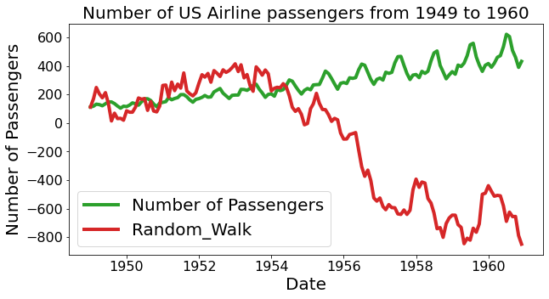

Random Walk Model Example
Random Walk Model : $Y(t)=Y(t−1)+ε , ε\sim N(0,σ^{2})$
Time Series
Questions?
Time Series Models
Introduction
12/22
5/12

Slide 15
Time Series Models
Preparing the data. (Make it stationary)
Time Series
Questions?
Time Series Models
Introduction
13/22
5/12

Slide 16
MA Model
Moving Average (MA) models can be used to both forecast and smooth out time series data. The types of models include:
Simple Moving Average models
Exponentially Weighted Moving Average modes
Autoregressive Moving Average models
ARMA
ARIMA
SARIMA
Time Series
Time Series Models
Questions?
Introduction
14/22
5/12

Slide 17
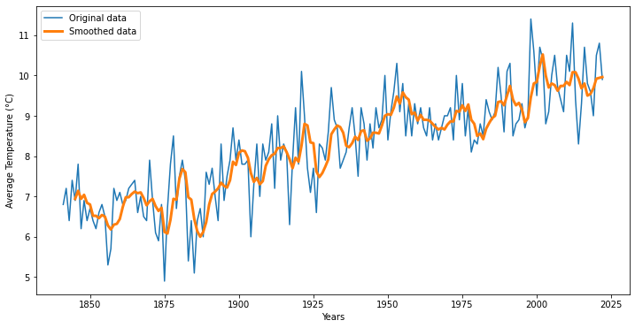
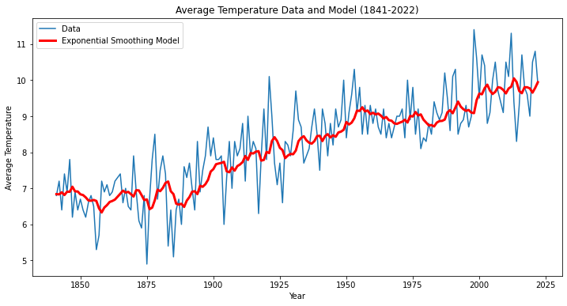
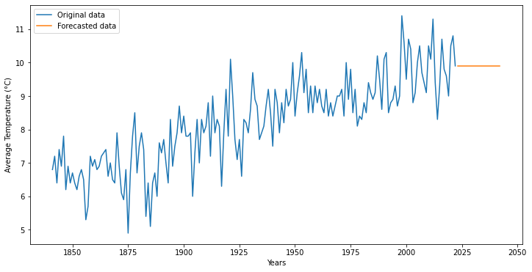
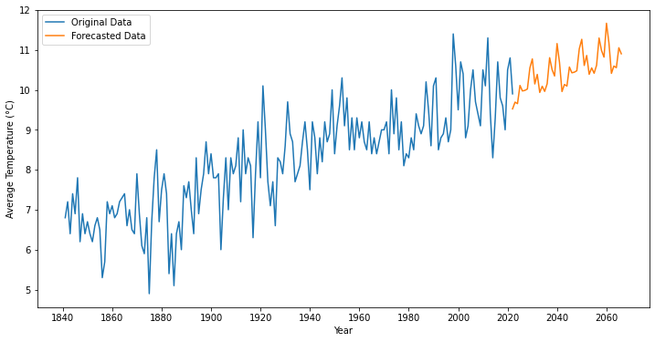
MA Models
Simple
MA models
Exponential
Smoothing
Time Series
Questions?
Time Series Models
Introduction
Forecasting
15/22
5/12

Slide 18
Error & Differencing
Error
Example: Let's say you are forecasting sales for the next month. Your last five predictions were
In a moving average model, these errors (-10, 5, -10, -2, -3) would be used as predictors to forecast sales for the next month.
Differencing
Differencing makes the time series stationary, meaning that its statistical properties (mean, variance, etc.) do not change over time.
To calculate the first difference of this time series, we subtract each value from the value in the previous period
The first difference time series data has a mean of close to zero, which indicates that it is stationary. If the original time series is not stationary, we can continue differencing until it becomes stationary.
Year | 1 | 2 | 3 | 4 | 5
Actual | 90 | 100 | 115 | 112 | 118
Forecasting | 100 | 95 | 105 | 110 | 115
Error | -10 | 5 | -10 | -2 | -3
Time Series
Questions?
Time Series Models
Introduction
Year | 1 | 2 | 3 | 4 | 5
Actual | 100 | 110 | 105 | 95 | 100
1st Difference | - | 10 | -5 | -10 | 5
16/22
5/12

Slide 19
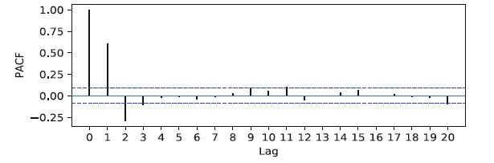
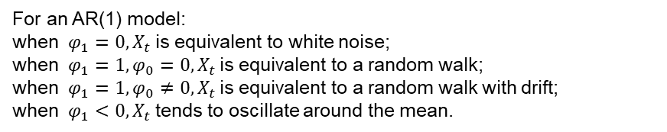


AR Models
Autoregressive (AR) Models
Time series {$X_{t}$} must be stationary to use this model.
$$X_{t}=φ_{0}+φ_{1}X_{t−1}+φ_{2}X_{t−2}+ …+φ_{p}X_{p−2}+ε_{t}$$
Order, p of AR model can be judged by a Partial Auto Correlation Function (PACF), to get best possible prediction using the simplest possible model.
PACF gives us a quantitative measure of the direct effect of a given lag on the quantity being predicted, eliminating the effects of intermediate lag terms.
Autoregression works well but can be used along with moving average models to better forecast the data.
Factors Affecting Variable
Not Considered, unlike regression
Past Values
Act as Predictors
white noise
Time Series
Questions?
Time Series Models
Introduction
From PACF Plot, Only lags 1 and 2 are enough to model this process:
$$X_{t}=φ_{0}+φ_{1}X_{t−1}+φ_{2}X_{t−2}+ε_{t}$$
For an AR(1) model:
when $φ_{1}=0,X_{t}$is equivalent to white noise;
when $φ_{1}=1,φ_{0}=0, X_{t}$is equivalent to a random walk;
when $φ_{1}=1,φ_{0}≠0, X_{t}$is equivalent to a random walk with drift;
when $φ_{1}<0, X_{t}$tends to oscillate around the mean.
17/22
5/12

Slide 20
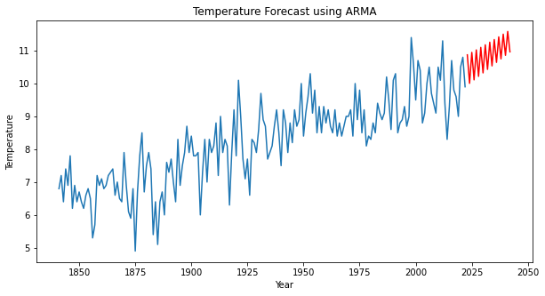
ARMA Models
Autoregressive Moving Average (ARMA)
ARMA is the combination of the AR and MA models. It predicts the future values based on both the previous values and errors. Thus, ARMA has better performance than AR and MA models alone.
Time Series
Questions?
Time Series Models
Introduction
# AR terms
# MA terms
model = ARMA(df['Temperature'], order=(3, 1))
result = model.fit()
18/22
5/12

Slide 21
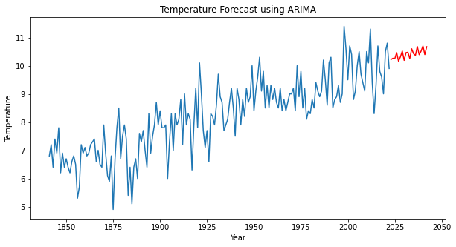
ARIMA Models
Autoregressive Integrated Moving Average (ARIMA)
Similar to ARMA models. The difference between ARMA and ARIMA is the integration part. The integrated I stands for the number of times differencing is needed to make the times series stationary.
Time Series
Questions?
Time Series Models
Introduction
# AR terms
# Order of differencing
# MA terms
model = ARIMA(df['Temperature'], order=(5, 2, 3))
result = model.fit()
19/22
5/12

Slide 22
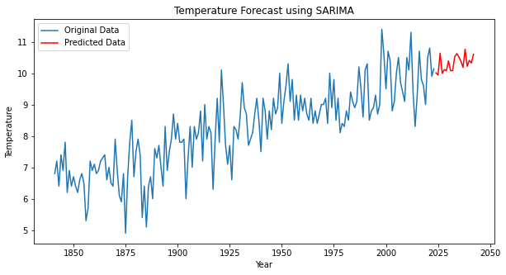
SARIMA Models
Seasonal Autoregressive Integrated Moving Average (SARIMA)
SARIMA is an extension of ARIMA that explicitly supports univariate time series data with a seasonal component.
Time Series
Questions?
Time Series Models
Introduction
#seasons (e.g. 12 for monthly data, 4 for quarterly data)
model = SARIMAX(df['Temperature'], order=(2, 1, 2), seasonal_order=(1, 1, 1, 12))
20/22
5/12

Slide 23
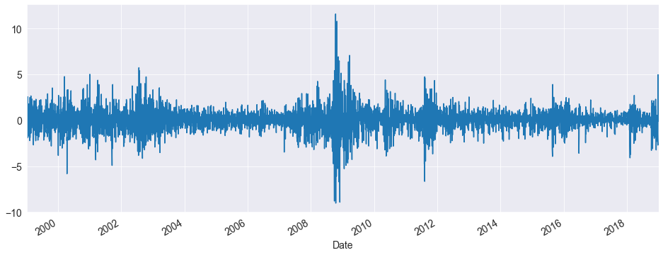
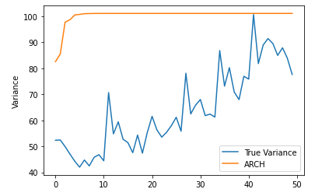

ARCH Model
Auto Regressive Conditional Heteroskedastic (ARCH)
This method models the volatility (variance) of the current residual as a function of the variance of past residuals.
Fit a best possible time series model to a dataset, and plot the residuals i.e. the differences between the predictions and the actual historical values.
Time series {${\text{X}}_{\text{t}}$} must be stationary other than conditional change in variance.
Obtain squares of error terms and regress them:
$$ε_{t}=σ_{t}z_{t}$$
$${σ^{2}}_{t}=α_{0}+α_{1}{ε^{2}}_{t−1}+ …+α_{q}{ε^{2}}_{t−q}=α_{0}+\sum_{i=1}^{q}{α_{i}{ε^{2}}_{i−i}}$$
Where $α_{0}>0,α_{i}≥0, i>0$
Volatility in the model tends to have a pattern
Time Series
Questions?
Time Series Models
Introduction
What if we model this volatility and modify the error term in our model?
21/22
5/12
Variance Predicted by ARCH(2) model on a dataset.

Slide 24
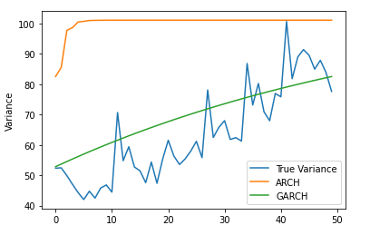

GARCH Model
Generalized Auto Regressive Conditional Heteroskedastic (GARCH)
This model is an extension of ARCH model in which moving average model is assumed for error variance
Thus, GARCH incorporates the ARMA model into ARCH, which only consists of AR.
A GARCH $(p,q)$model can be described as:
$$ε_{t}=σ_{t}z_{t}$$
${σ^{2}}_{t}=ω+α_{1}{ε^{2}}_{t−1}+ …+α_{q}{ε^{2}}_{q−1}+$ $β_{1}{σ^{2}}_{t−1}+ …+β_{p}{σ^{2}}_{p−1}$
${σ^{2}}_{t}=$ $ω+\sum_{i=1}^{q}{α_{i}{ε^{2}}_{i−1}}+\sum_{i=1}^{p}{β_{i}{σ^{2}}_{i−1}}$
ARCH Terms
GARCH Terms
Time Series
Questions?
Time Series Models
Introduction
q is number of lag squared residual errors
p is the order of auto-regression for error variance
22/22
5/12
Variance Predicted by ARCH(2) model vs GARCH(1,2) model on a dataset

Slide 25
References:
[1] "Time Series Analysis in Python – A Comprehensive Guide with Examples," Machine Learning Plus, [Online]. Available: https://www.machinelearningplus.com/time-series/time-series-analysis-python/.
[2] "ARIMA Model – Complete Guide to Time Series Forecasting in Python," Machine Learning Plus, [Online]. Available: https://www.machinelearningplus.com/time-series/arima-model-time-series-forecasting-python/.
Thank You For Your Attention!
Time Series
Questions?
Introduction
Time Series Models
5/12

